Slide 1
Few Programs with loop
Rakib Mahmud

Slide 2
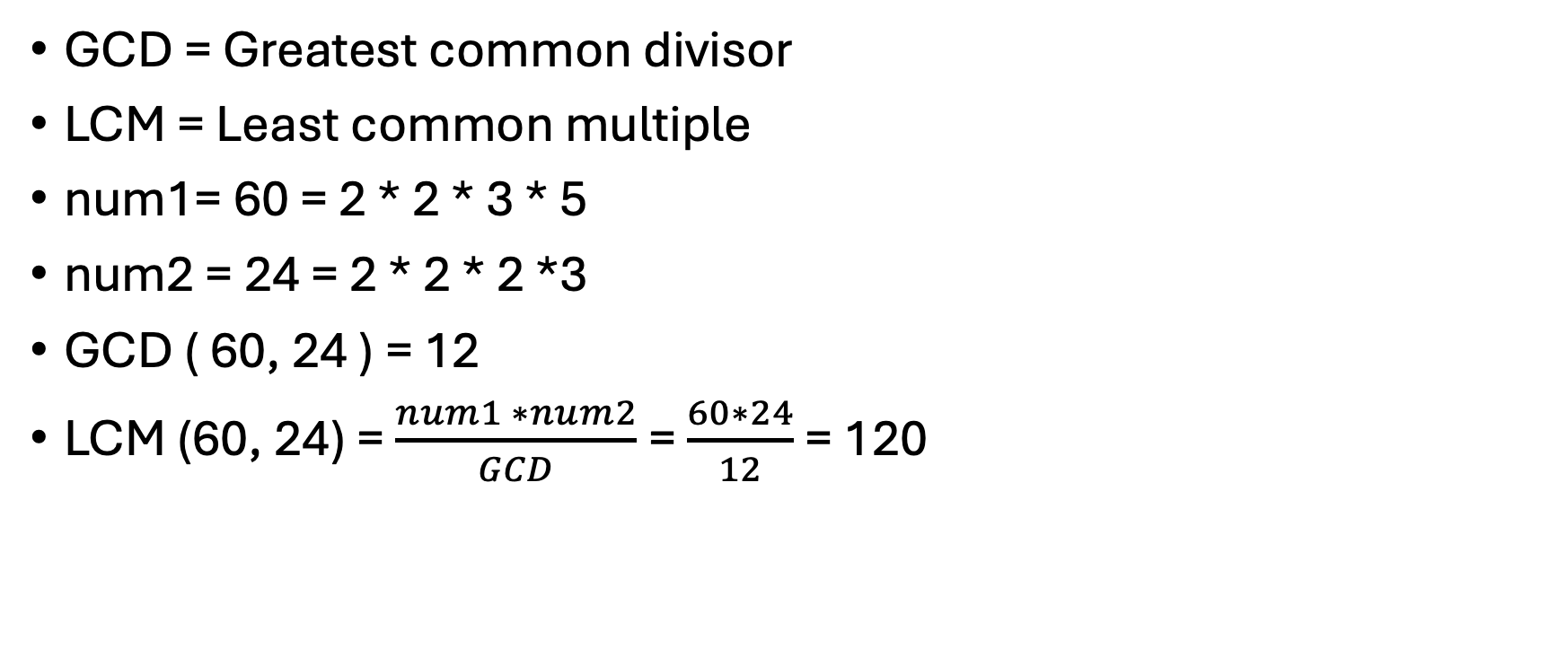
GCD and LCM
GCD = Greatest common divisor
LCM = Least common multiple
num1= 60 = 2 * 2 * 3 * 5
num2 = 24 = 2 * 2 * 2 *3
GCD ( 60, 24 ) = 12
LCM (60, 24) = $\frac{num1 ∗num2}{GCD}$ = $\frac{60∗24}{12}$ = 120
n1 | n2 | n1%n2
60 | 24 | 12
24 | 12 | 0
12 | 0

Slide 3
Flowchart to find GCD and LCM of Two Integers
Start
Input num1,num2
n1 = num1
n2 = num2
n2 !=0
No
Yes
rem = n1%n2
n1= n2
n2=rem
gcd = n1
lcm=(num1*num2)/gcd
Print gcd, lcm
end

Slide 4
Algorithm to find GCD and LCM of Two Integers
Start
Input num1, num2
Set n1 = num1, n2 = num2
while (n2 !=0):
reminder = n1%n2
n1=n2
n2 = reminder
gcd=n1, lcm=(num1*num2)/gcd
Print gcd, lcm.
end

Slide 5
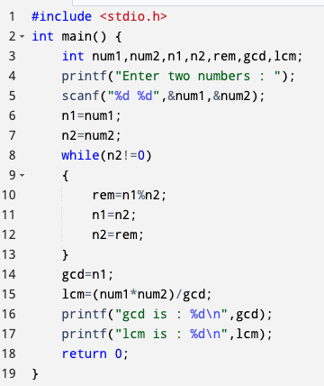
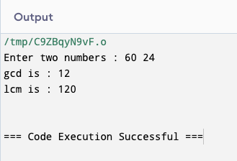
C program to find GCD and LCM of Two Integers

Slide 6
Flowchart for sum of the digits of an integer
Start
Input num
sum = 0, temp = num
temp != 0
No
print sum
Yes
rem = temp%10
sum = sum + rem
temp = temp/10
End

Slide 7
Algorithm for sum of the digits of an integer
Start
Input a number
temp = num, sum=0
while (temp!=0):
rem = temp%10
sum = sum + rem
temp = temp/10
Print sum
end

Slide 8
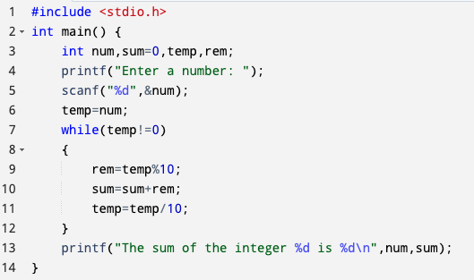
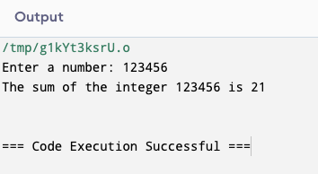
C program for sum of the digits of an integer

Slide 9
Flowchart to reverse an integer
Start
Input num
sum = 0, temp = num
temp != 0
No
print sum
Yes
rem = temp%10
sum = sum*10 + rem
temp = temp/10
End

Slide 10
Alogrithm to reverse an integer
Start
Input a number
temp = num, sum=0
while (temp!=0):
rem = temp%10
sum = sum*10 + rem
temp = temp/10
Print sum
end

Slide 11
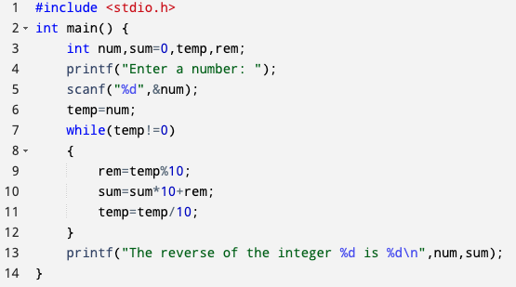
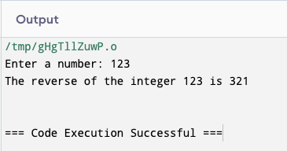
C program to reverse an integer

Slide 12
Palindrome number
A palindrome number is a number that remains the same when its digits are reversed.
For example: 525, 12321

Slide 13
Flowchart to check if a number is palindrome or not
Start
Input num
sum = 0, temp = num
temp != 0
No
sum == num
No
Yes
Yes
Print not palindrome number
Print palindrome number
rem = temp%10
sum = sum*10 + rem
temp = temp/10
End

Slide 14
Algorithm to check if a number is palindrome or not
Start
Input a number
temp = num, sum=0
while (temp!=0):
rem = temp%10
sum = sum*10 + rem
temp = temp/10
Is (num==sum):
Yes, print it is a palindrome number
No, print it is not a palindrome number
End

Slide 15
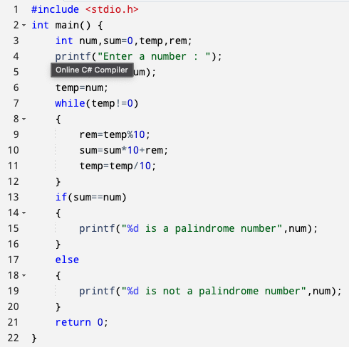
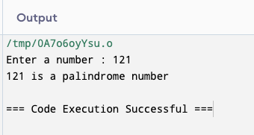
C program to check if a number is palindrome or not

Slide 16
Flowchart for counting number of a digit in an integer
Start
Input num
count = 0, temp = num
temp != 0
No
Print count
Yes
Count++,
temp = temp/10
End

Slide 17
Algorithm for counting number of a digit in an integer
Start
Input a number
temp = num, count=0
While (temp!=0):
count++
temp = temp/10
Print count
end

Slide 18
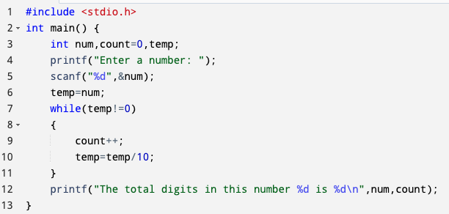
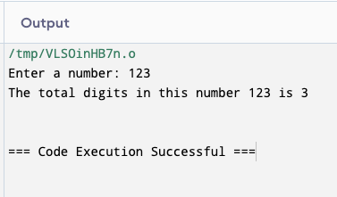
C program for counting number of a digit in an integer

Slide 19
Armstrong number
An armstrong number (also known as a Narcissistic number) for a given number of digits is a number that is equal to the sum of its own digits each raised to the power of the number of digits.
For example:
153 is an Armstrong number because 153 = 1³+5³+3³.
1634 is an Armstrong number because 1634 = 1⁴+6⁴+3⁴+4⁴ = 1 + 1296 + 81 + 256

Slide 20
Flowchart to check an integer is armstrong or not.
Start
temp = num
Input num
temp != 0
No
sum == num
Yes
count = 0, temp = num
rem = temp%10
sum = sum+pow(rem,count)
temp = temp/10
Yes
No
temp != 0
No
Yes
Count++,
temp = temp/10
Print armstrong number
Print not armstrong number
End

Slide 21
Algorithm to check an integer is armstrong or not.
Start
Input a number
temp = num, count=0
while (temp!=0):
count++
temp = temp/10
temp=num
while (temp!=0):
rem = temp%10
sum = sum + pow(rem,count)
temp = temp/10
Is (num==sum):
Yes, print it is an Armstrong number
No, print it is not an Armstrong number
End

Slide 22
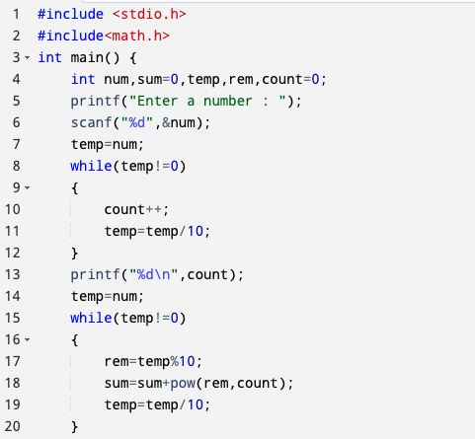
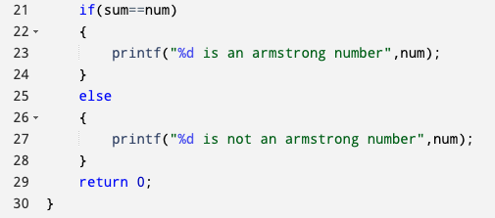
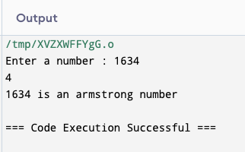
C program to check if a number is armstrong or not

Slide 23
Flowchart to check if a number is prime, co-prime or not
Start
Input num
num==1
Yes
Print co prime
No
num==2 || num ==3
Yes
Print prime
No
i=2, count=0
No
Yes
i<=(num/2)
Count==0
Yes
Num%i==0
No
No
Yes
count=1
Print not prime
Print prime
i= i+1
End

Slide 24
Algorithm to check if a number is co-prime, prime or not
Start
Input num
i=2, count=0
Is (num==1):
Yes, print co-prime and go to step 9
No, go to next step
Is (num==2) OR (num==3):
Yes, print prime and go to step 9
No, go to next step
Is i <= (num/2):
Yes, go to step 7
No, go to step 8
Is (num % i) == 0:
Yes, count = 1, go to step 8
No, go to step 6
Is (count == 0):
Yes, print prime number
No, print not prime number
End

Slide 25
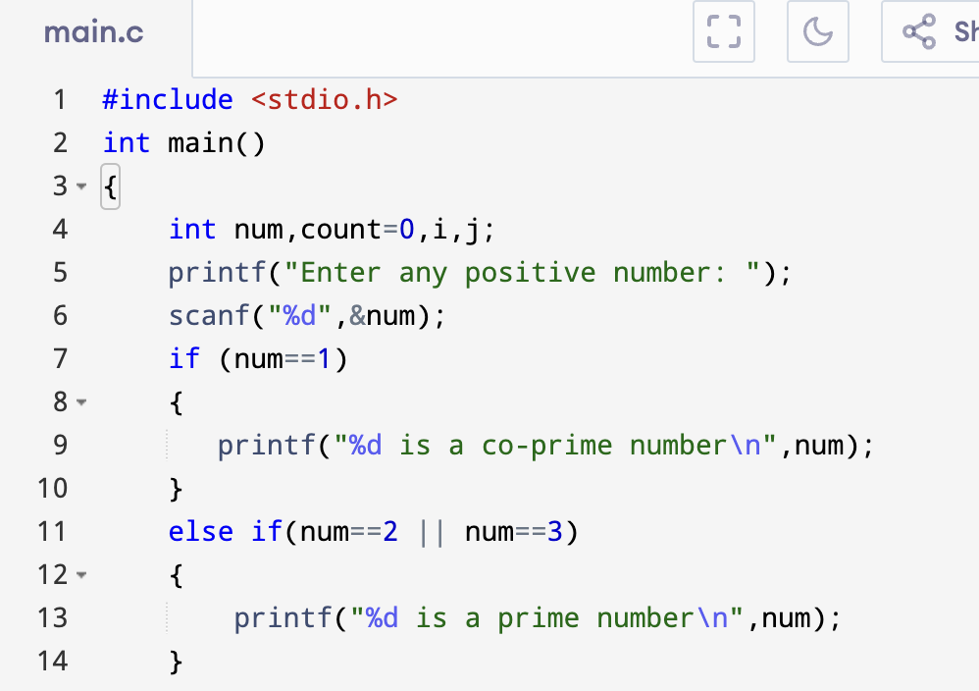
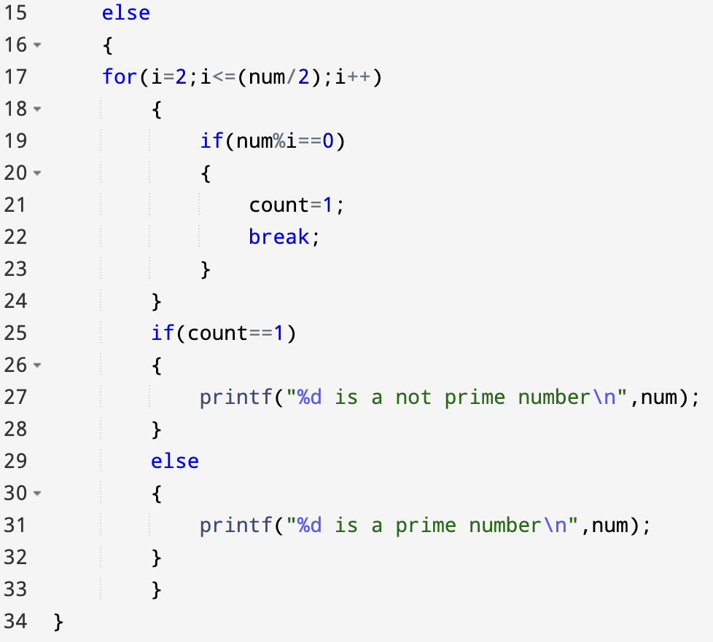
C program to check if a number is co-prime, prime or not

Slide 26
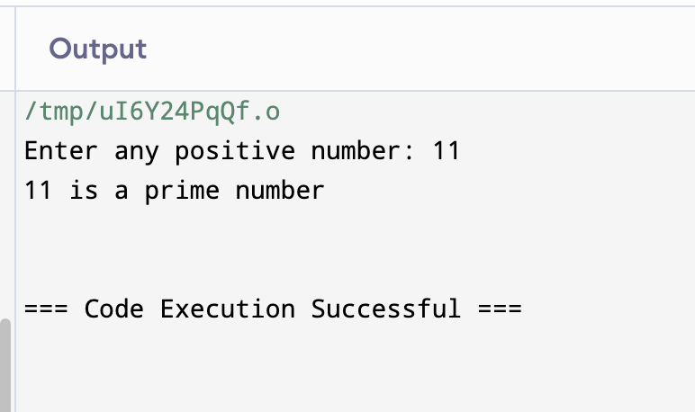
C program to check if a number is co-prime, prime or not

Slide 27
Strong Number
Strong Numbers are the numbers whose sum of factorial of digits is equal to the original number.
Example:
n = 145 Sum of digit factorials = 1! + 4! + 5! = 1 + 24 + 120 = 145
So, it is a strong number.

Slide 28
Exercises
Write a c program to find prime numbers from 1 to 100.
Write a c program to check if a number is strong or not

Slide 29
Thank You

